Slide 1
I Rap, You Rap, We All Love the IRAP: Manipulations of Sample Stimuli and Instructions
Chair: Kail Seymour, M.S., BCBA
Discussant: Kate Kellum, University of Mississippi

Slide 2
Love/Hate Faked: Manipulating IRAP Performance with Instructions
Kail Seymour, M.S., BCBA
Christine Ryder, B.A.
Chad E. Drake, Ph.D.

Slide 3
What is Faking?
“self-presentational biases or deliberate attempts to conceal socially sensitive attitudes”

Slide 4
Why Does Faking Matter?
Predictive validity Issues
May be important to assess when, where, and how implicit measures break down

Slide 5
Faking the Implicit Associations Test (IAT)
Resistant…
Banse, Seise, and Zerbes (2001)
Asendorpf, Banse, and Mücke (2002)
Egloff & Schmukle (2002)
…but not immune
Kim (2003)
Fiedler and Bluemke (2005)
Cvencek, Greenwald, Brown, Gray, and Snowden (2010)

Slide 6
Rapid Response Methodology
Using surveys to gauge bias often appears to be inadequate
Quick (e.g., ≤ 2000 ms), keyboard response measures prevent or deter explicit attitude expression

Slide 7
Faking the IRAP: McKenna et al. (2007)
Kim (2003)
McKenna, Barnes-Holmes, Barnes-Holmes, and Stewart (2007)

Slide 8
Consistent Blocks: McKenna et al. (2007)
Pleasant
Good
Unpleasant
Good
Caress, Freedom, Health, Love, Peace, Cheer
Press ‘d’ for Similar
Press ‘k’ for
Opposite
Press ‘d’ for Similar
Press ‘k’ for
Opposite
Pleasant
Bad
Unpleasant
Bad
Abuse, Crash, Filth, Murder, Sickness, Accident
Press ‘d’ for Similar
Press ‘k’ for
Opposite
Press ‘d’ for Similar
Press ‘k’ for
Opposite

Slide 9
Inconsistent Blocks: McKenna et al. (2007)
Pleasant
Good
Unpleasant
Good
Press ‘d’ for Similar
Press ‘k’ for
Opposite
Press ‘d’ for Similar
Press ‘k’ for
Opposite
Pleasant
Bad
Unpleasant
Bad
Press ‘d’ for Similar
Press ‘k’ for
Opposite
Press ‘d’ for Similar
Press ‘k’ for
Opposite

Slide 10
Faking the IRAP: McKenna et al. (2007)
Pre-IRAP
Standard IRAP
Faking instructions and Quiz
Faking IRAP
Faking Strategy Questionnaire

Slide 11
McKenna (2007): Key Results
Manipulation check: Success
Significant IRAP effect
The faking group had slightly less bias than the control group

Slide 12
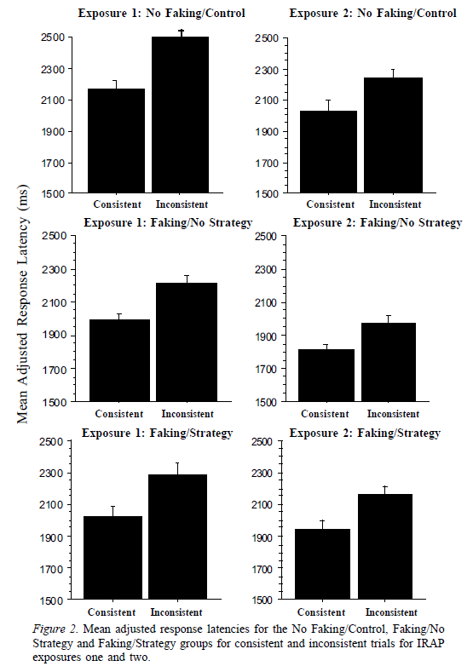
McKenna (2007): Key Results

Slide 13
Design Differences: Surveys
Acceptance and Action Questionnaire-II
Demographic Information
Relationship Structures Questionnaire (ECR-RS-M)
Hitler-Lincoln Questionnaire
Multidimensional Scale of Perceived Social Support
Negative Relationship Questionnaire
Outcome Questionnaire 45
Positive Relationship Questionnaire
Semantic Differential Scale
Valued Time and Difficulty Questionnaire (VTDQ)

Slide 14
Design Differences: Groups & Conditions
Participants randomly assigned to four groups
Surveys → Standard IRAP → Standard IRAP → Faking IRAP
Surveys → Standard IRAP → Faking IRAP → Faking IRAP
Standard IRAP → Standard IRAP → Faking IRAP → Surveys
Standard IRAP → Faking IRAP → Faking IRAP → Surveys

Slide 15
Design Differences: Names Questionnaire
Please print the name of someone who you personally know and have a positive relationship with. By positive, we mean…
Please print the name of someone who you personally know and have a negative relationship with. By negative, we mean…

Slide 16
Design Differences: Stimulus Pairings
Stimulus differences
Idiographic sample stimuli
Evaluative target samples
Response key stimuli

Slide 17
Design Differences: Stimulus Pairings
Pleasant
Good
Unpleasant
Good
Caress, Freedom, Health, Love, Peace, Cheer
Press ‘d’ for Similar
Press ‘k’ for
Opposite
Press ‘d’ for Similar
Press ‘k’ for
Opposite
Pleasant
Bad
Unpleasant
Bad
Abuse, Crash, Filth, Murder, Sickness, Accident
Press ‘d’ for Similar
Press ‘k’ for
Opposite
Press ‘d’ for Similar
Press ‘k’ for
Opposite

Slide 18
Design Differences: Stimulus Pairings
Name of Positive Person
Good
Name of Negative Person
Good
Good, Safe, Caring, Friend, Nice, Trustworthy
Press ‘d’ for True
Press ‘k’ for
False
Press ‘d’ for True
Press ‘k’ for
False
Name of Positive Person
Bad
Name of Negative Person
Bad
Bad, Cruel, Dangerous, Enemy, Hateful, Selfish
Press ‘d’ for True
Press ‘k’ for
False
Press ‘d’ for True
Press ‘k’ for
False

Slide 19
Design Differences: Instructions
First standard IRAP Instructions:
McKenna et al. (2007)
Consent form
A brief description of the procedures and instructions for completing the IRAP
The IRAP was conducted
Current study
Extended training before each IRAP practice block
In Vivo feedback for consistent inaccurate responding

Slide 20
Design Differences: Standard IRAP Training
Goody Gooderson
Good
Jerky McBadderson
Good
Choose This
Choose This
Press ‘d’ for
True
Press ‘k’ for
False
Press ‘d’ for
True
Press ‘k’ for
False
Goody Gooderson
Bad
Jerky McBadderson
Bad
Choose This
Choose This
Press ‘d’ for
True
Press ‘k’ for
False
Press ‘d’ for
True
Press ‘k’ for
False

Slide 21
Design Differences: Standard IRAP Training
Goody Gooderson
Good
Jerky McBadderson
Good
Choose This
Choose This
Press ‘d’ for
True
Press ‘k’ for
False
Press ‘d’ for
True
Press ‘k’ for
False
Goody Gooderson
Bad
Jerky McBadderson
Bad
Choose This
Choose This
Press ‘d’ for
True
Press ‘k’ for
False
Press ‘d’ for
True
Press ‘k’ for
False

Slide 22
Design Differences: Faking Instructions
On the previous task you may have noticed that half of the task was a bit easier than the other half. For example, you may have found it easier to select “true” when seeing the name of a person you like combined with a positive word and more difficult when you had to select “false”. This task measures how quickly you are able to select the required answer, and we usually see slight differences in the amount of time it takes to select true compared to the amount of time to select false. This task is similar to a lie detector, because this pattern usually occurs even when the person doesn’t want it to. However, there are ways to fool a lie detector, and we are wondering if it is also possible to fool this task. We are doing this study because we think it may be possible to outsmart this measure. I am going to give you some simple instructions on how to hide your true feelings about the people in this task.
Would you be willing to try to fake this procedure?

Slide 23
Design Differences: Faking Instructions
Okay, good. You are going to do the same exact task as before. The first block will be the easier one – where you select true for a good person paired with a positive word and for a bad person with a negative word. Here is the rule for you to follow to fool the task: Respond within the time limit, but otherwise do not try to go fast. When you know what answer to provide, do not immediately react. Respond more slowly than you normally would. The idea is to go as slowly as you can without going over the time limit.

Slide 24
Design Differences: Faking Quiz 1
For the easier block of trials (good person goes with good qualities, bad person goes with bad qualities), what strategy are you supposed to use to fake your actual attitudes?
Carefully rehearse the necessary answers before beginning and then respond as quickly and accurately as possible
Respond inaccurately – choose the opposite of what you think
Respond accurately but as slowly as possible within the time limit
Respond accurately and ignore the time limit

Slide 25
Design Differences: Faking IRAP Training
Goody Gooderson
Good
Jerky McBadderson
Good
Choose This
Choose This
Press ‘d’ for
True
Press ‘k’ for
False
Press ‘d’ for
True
Press ‘k’ for
False
Goody Gooderson
Bad
Jerky McBadderson
Bad
Choose This
Choose This
Press ‘d’ for
True
Press ‘k’ for
False
Press ‘d’ for
True
Press ‘k’ for
False

Slide 26
Design Differences: Faking Instructions
Now you are going to do the more difficult block – where you select false for a good person paired with a good characteristic and for a bad person paired with a bad characteristic. The key to fooling the task on this block is to rehearse the answers very well before you start. Then, once you begin the block, just do as well as you can. Don’t start until you are ready and feel confident about the answers you are supposed to select.

Slide 27
Design Differences: Faking Quiz 2
For the difficult block of trials (good person goes with bad qualities, bad person goes with good qualities), what strategy are you supposed to use to fake your actual attitudes?
Carefully rehearse the necessary answers before beginning and then respond as quickly and accurately as possible
Respond inaccurately – choose the opposite of what you think
Respond accurately but as slowly as possible within the time limit
Respond accurately and ignore the time limit

Slide 28
Design Differences: Final Quiz
3. Overall, how closely did you follow the faking instructions during the task?
4. How closely did you follow the faking instructions for the easy blocks (responded accurately but as slowly as possible within the time limit)?
5. How closely did you follow the faking instructions for the difficult blocks (responded accurately …)?
not at all 0 1 2 3 4 5 6 7 8 9 10 perfectly

Slide 29
Design Differences: Final Quiz
6. Overall, how successful do you think you were at faking your performance on the task?
7. How successful do you think you were in faking your performance on the trials containing a good person and a good quality?
8. Good:Bad
9. Bad:Good
10. Bad:Bad
not at all successful to Extremely Successful

Slide 30
Participants
Sample of convenience:
n = 57
Age:18 to 25
Undergraduates enrolled in an introductory psychology course
Course credit for participating
Participants self-selected for slots based on date/time availability

Slide 31
Manipulation Check
-5 to 5 scale |  | Good Words | Bad Words
Target Stimuli |  | 3.89 | -3.58
1 to 11 scale |  | Positive Thoughts/ Feelings | Negative Thoughts/ Feelings
Negative Person |  | 3.97 | 7.95
Positive Person |  | 10.55 | 2.38
1 to 7 scale |  | Is a good person | Is a bad person
Negative Person |  | 3.2 | 4.8
Positive Person |  | 6.7 | 1.3

Slide 35
Results
Similar Conditions IRAP Effects
Significant pro-friend bias for the first IRAP (Standard)
Significant pro-enemy bias for the third IRAP (Faking)
Overall D
IRAP 1: No significant difference in average D-scores Groups
IRAP 2: A significant difference in average D-scores between the groups
IRAP 3: No significant difference in average D-scores Groups

Slide 36
Discussion
Faking achieved
Extensive, Interpersonal instructions
Size and the consistency of the faking DIRAP scores
Confirmation
Extend our understanding
What dimensions can we manipulate to make faking difficult using these instructions
What does it take to create “undetectable faking”

Slide 37
